Slide 1

GOVERNMENT COLLISION PREVENTION
By Rolando Mancilla-Rojas and Adebola Odutola

Slide 2


WHOA!
💁‍♂️
🤨
23 Years Old
Data Analyst @ The Marcy Lab School
=================
Project Management
Modeling
GitHub
App Deployment
21 Years Old
Data Analyst @ The Marcy Lab School
==================
EDA
GitHub
Visuals
Cleaning
Feature Engineering

Slide 3
BOTTOM LINE UP FRONT
MODEL PURPOSE
SOLUTIONS
ETHICS
Model support efforts in targeted training, resource allocation, & strategic planning.
Model provides percentage likelihood of collisions causing injury/death, with adjustable features to infer critical boroughs or seasons.
Model is not built to punish workers.
Should be used alongside normal DCAS investigatory operations, not solely relied on.

Slide 4
TABLE OF CONTENTS
01
02
03
04
BACKGROUND
MODEL
CONTEXT, INITIAL INSIGHTS
OUTPUT, USAGE, LIMITATIONS
DEMO
ETHICS & BIAS
WORKING MODEL, TUTORIAL
IMPLICATIONS, ASSUMPTIONS, PURPOSE

Slide 5
01
BACKGROUND

Slide 6
CONTEXT FROM EDA:
IMPORTANCE
INTERESTING FINDINGS
Government-owned vehicles are involved in at 157817/370001(~43%)
184627 total people affected by vehicle crashes with government-owned vehicles
Behind ‘unspecified’, driver’s inattention was the main causes of the collisions
Looking at the data provided, we noticed a large number of collisions involving government vehicles. To help the stakeholder properly allocate resources to training these drivers, we built a model.

Slide 7
02
MODEL

Slide 8
ALL ABOUT THE MODEL
LOGISTIC MODEL
INFERENTIAL
Gives us a percentage likelihood of collisions causing injury/death.
This model is best used to aid investigatory operations into which boroughs need training, during which seasons.
PREDICTIONS
EVALUATION
Roughly imbalanced, initially captured less injury/death events due to disproportionate data.
Prioritized recall, attempting to report more injury/death collisions to prevent missed events.

Slide 9
03
DEMO

Slide 10
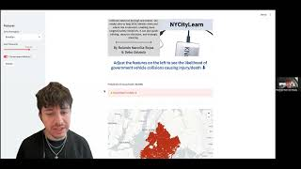
DEMO VIDEO
Quick Demo of our deployed predictive model, and a showcase of the added features.

Slide 11
04
ETHICS & BIAS

Slide 12
ETHICS AND BIAS
ASSUMPTIONS
ETHICS
BIAS
TheFuzz correctly categorized (similarity threshold 70)
For all columns regarding vehicle types, we assumed that missing values in these rows did not indicate government vehicle involvement unless explicitly stated.
For the vehicles Ambulance, Bus, Garbage Truck, Delivery Truck, and Fire Truck, we assumed that they were all government-owned vehicles, not commercial or private
.
The EDA puts all vehicles contributing to a collision on one line, separated by "|". This may affect the specific count of government vehicles, but it correctly gives the number of collisions involving government vehicles.
We assumed that the type of government-owned vehicles is listed with priority over the style of vehicle. E.g., we assume that none of the vehicles listed as a Sedan are government-owned, or else they would have been listed as such.
Used solely for its purpose of targeted training to both improve the reputation of the stakeholder and NYC streets safer
If the model suggest high likelihood, we don’t want it used to justify increasing tax costs
If the model suggests low likelihood, we don’t want the chance of injury downplayed or hidden
Injury & Death are grouped together, which can dilute severity
  e.g. a bruise and a fatal crash are in the same category
The data provided comes from a MV104-AN police report, meaning that it’s possible the driver of the government-vehicle involved was the officer who filled out the form
  May account for large count of ‘unspecified’ as the cause of government-involved accidents

Slide 13
THANKS!
ANY QUESTIONS?

Slide 14
PREPROCESSING INCLUDES:
ONE HOT ENCODING
SPLITTING THE DATA
Our model reads numbers, not words. We need to transcribe for it by creating new columns, which flag if the condition holds true.
We need to split our data into 2 groups: train and test data.
This allows us to diagnose our model by giving it partial data to learn, and the other data to test it’s predictive power.
Example:
Is Brooklyn? → True/False
Model studies for the test, then we grade its performance

Slide 15
EDA
Our EDA consisted of
cleaning string inconsistencies (letter case, whitespace)
Using TheFuzz with a threshold of 70 to categorize vehicles
Making a flag to identify government vehicles
Analyzing the casualties and causes of the collisions with government-owned vehicles

Slide 16
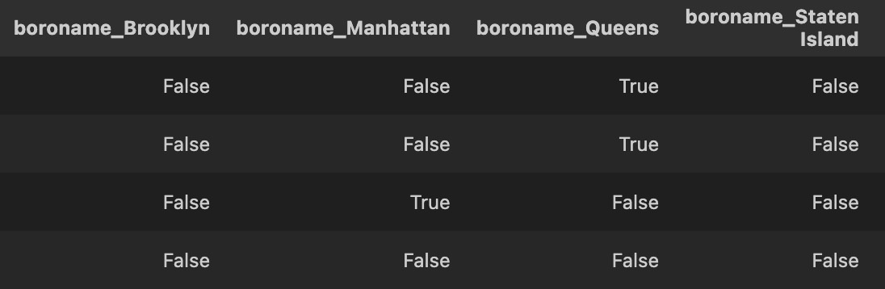
Instead of one column with 5 unique boroughs, we create binary columns that the model can interpret.
In integers, this is represented as:
True = 1 False = 0

Slide 17
CONTENTS OF THIS TEMPLATE
You can delete this slide when you’re done editing the presentation
Fonts | To view this template correctly in PowerPoint, download and install the fonts we used
Used and alternative resources | An assortment of graphic resources that are suitable for use in this presentation
Thanks slide | You must keep it so that proper credits for our design are given
Colors | All the colors used in this presentation
Icons and infographic resources | These can be used in the template, and their size and color can be edited
Editable presentation theme | You can edit the master slides easily. For more info, click here
For More Info:
Slidesgo | Blog | Faqs
You Can Visit Our Sister Projects:
Freepik | Flaticon | Storyset | Wepik | Videvo
Notes:
Ethics - wrongs predictions

Slide 18
THREE MODELS BUILT:
BASELINE
SIMPLE
COMPLEX/FINAL
Our simplest model, which serves as the minimum standard error to beat.
Our second, more interpretable model. Serves to ensure our selected variables are relevant.
Our final product. All of our variables are inputted in our tuned, optimized model.
Benchmark
Must Beat
Must beat

